Slide 1

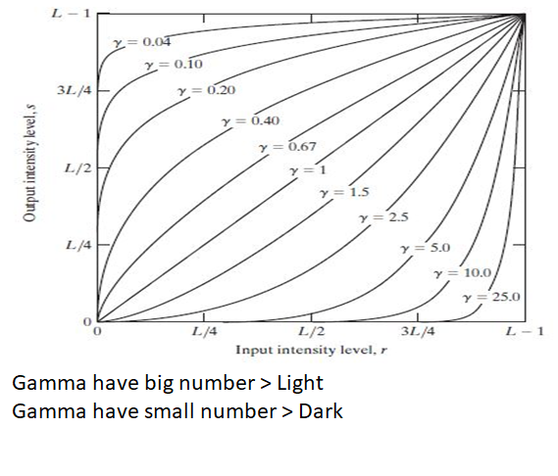
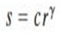
Digital Image Processing
16-Draw the transformation intensity function for gamma power transformation. Discuss briefly the effect of different gamma 𝛾 values on the output.
Dark
Light

Slide 2
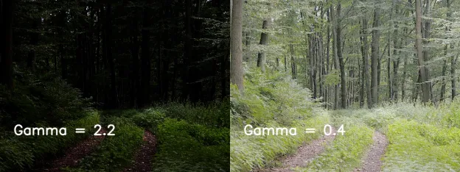
Digital Image Processing
16-Draw the transformation intensity function for gamma power transformation. Discuss briefly the effect of different gamma 𝛾 values on the output.

